Slide 1
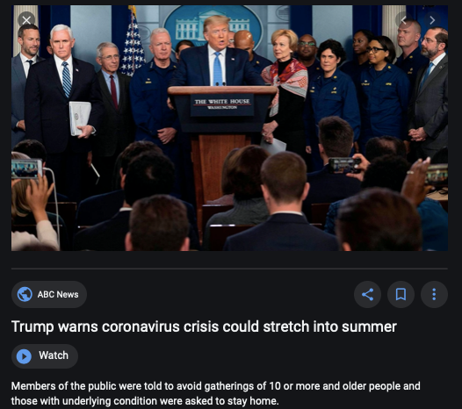
Coronavirus!
Stupidest People Alive:
This is crazy AF:
You gather together in a group of 50 to announce that everyone should avoid groups of ten or more?
The press doesn’t ask: what are we doing here?
The general advisors do not ask: what are we doing here?
The public health advisors do not ask: what are we doing here?
This sums up at least the American federal government’s reaction to the coronavirus crisis.
audio time

Slide 2
Where We Think We Are with Coronavirus
Brad DeLong
2020-05-06
< https://www.icloud.com/keynote/0YKEi7HeOrVGvKYtt9FEqH7nA>
<https://github.com/braddelong/public-files/blob/master/coronavirus.pptx>

Slide 3
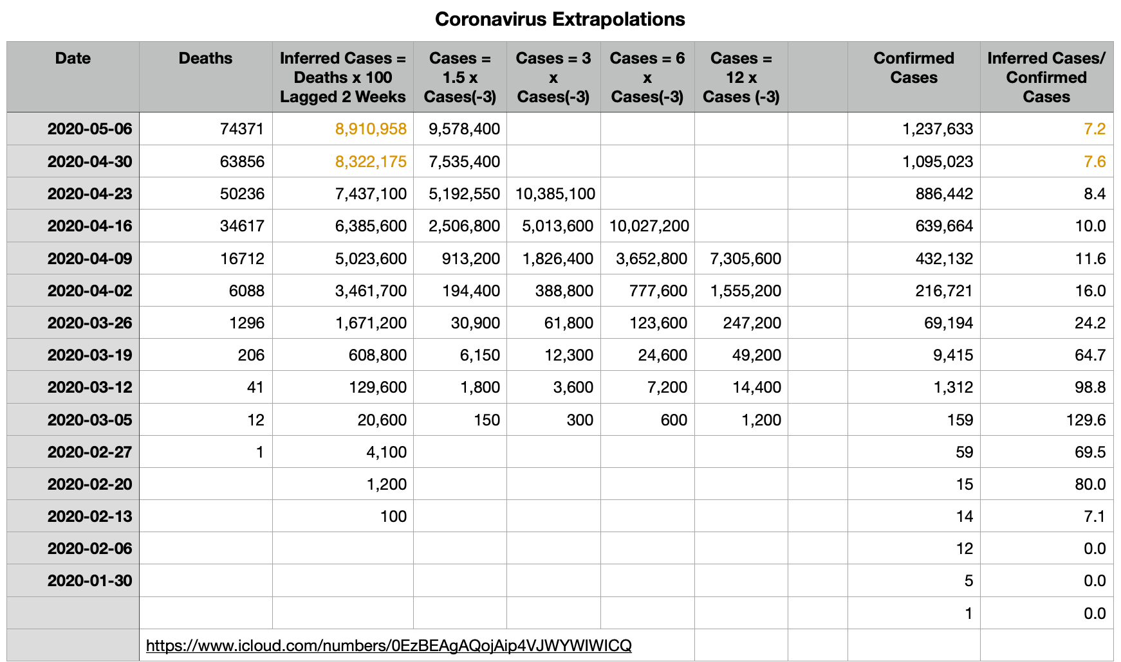
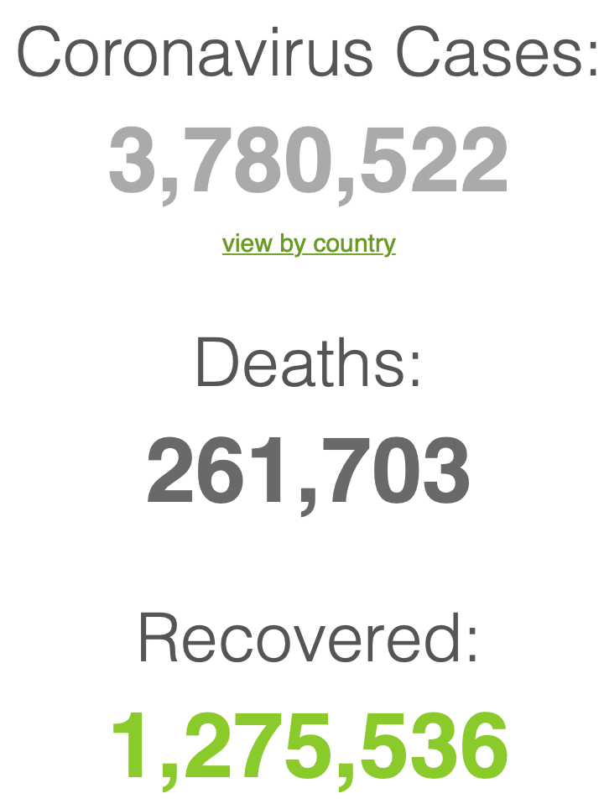
Simple Extrapolations and Inferences
Where we think we are, as of We May 6, 2020:
We still do not know: no random panel
I have my extrapolations: perhaps 9M cases?
Time to distinguish between Greater New York and the rest of the country?
audio time

Slide 5
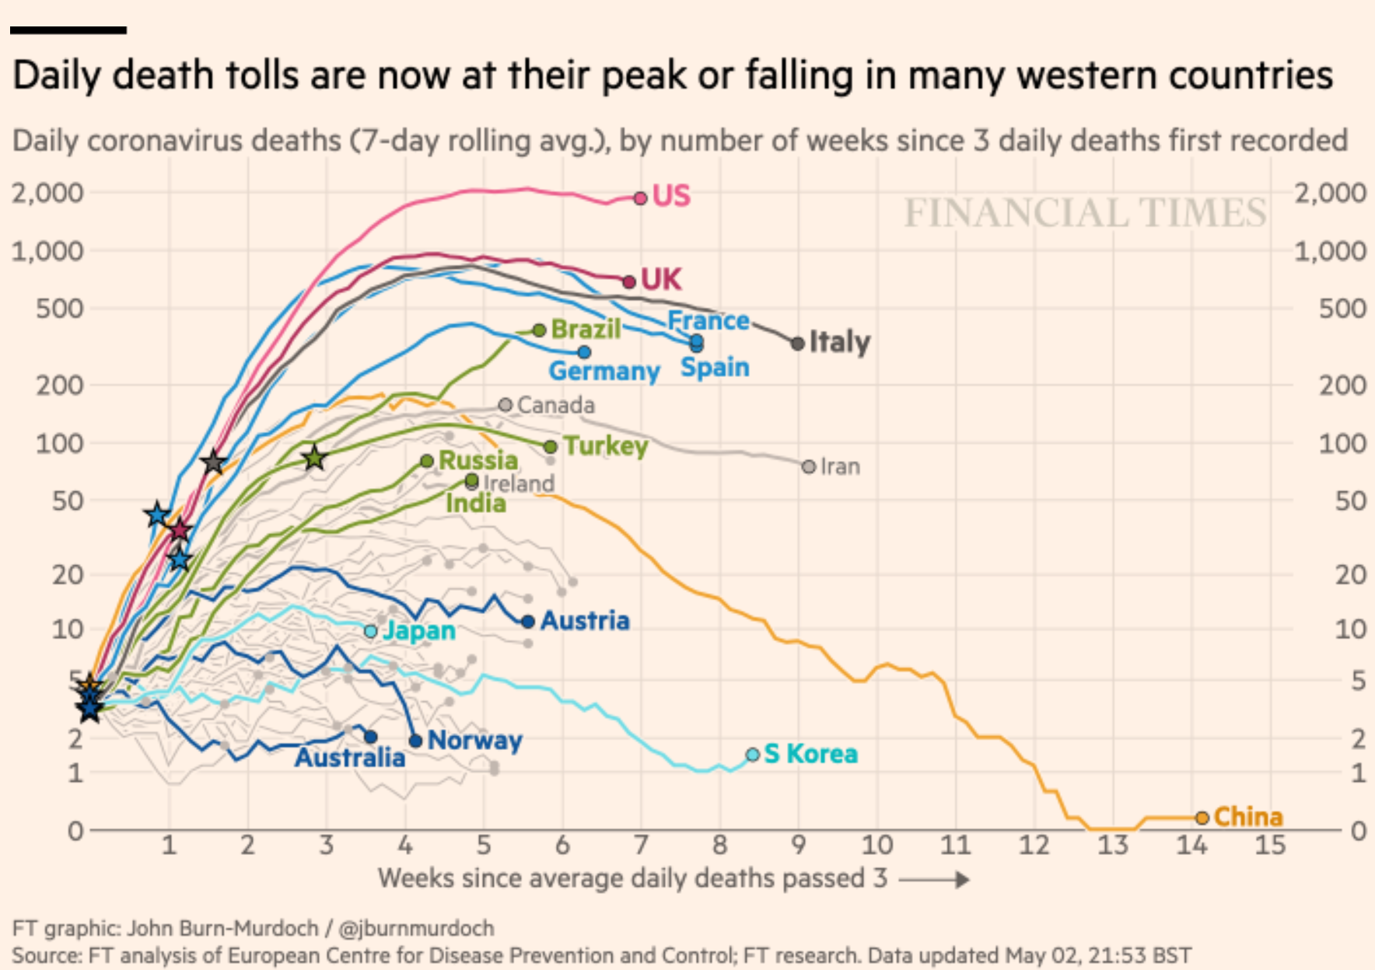
The United States Is Alone in Doing No More than Flattening the Death Line
And that is including New York:
And odds are that the U.S. daily death curve is about to start heading northeast again
How far and how fast will it move?
Cases x 150 during March
Cases x 3 during April
Am I wrong to expect a doubling outside New York in May?
audio time

Slide 6
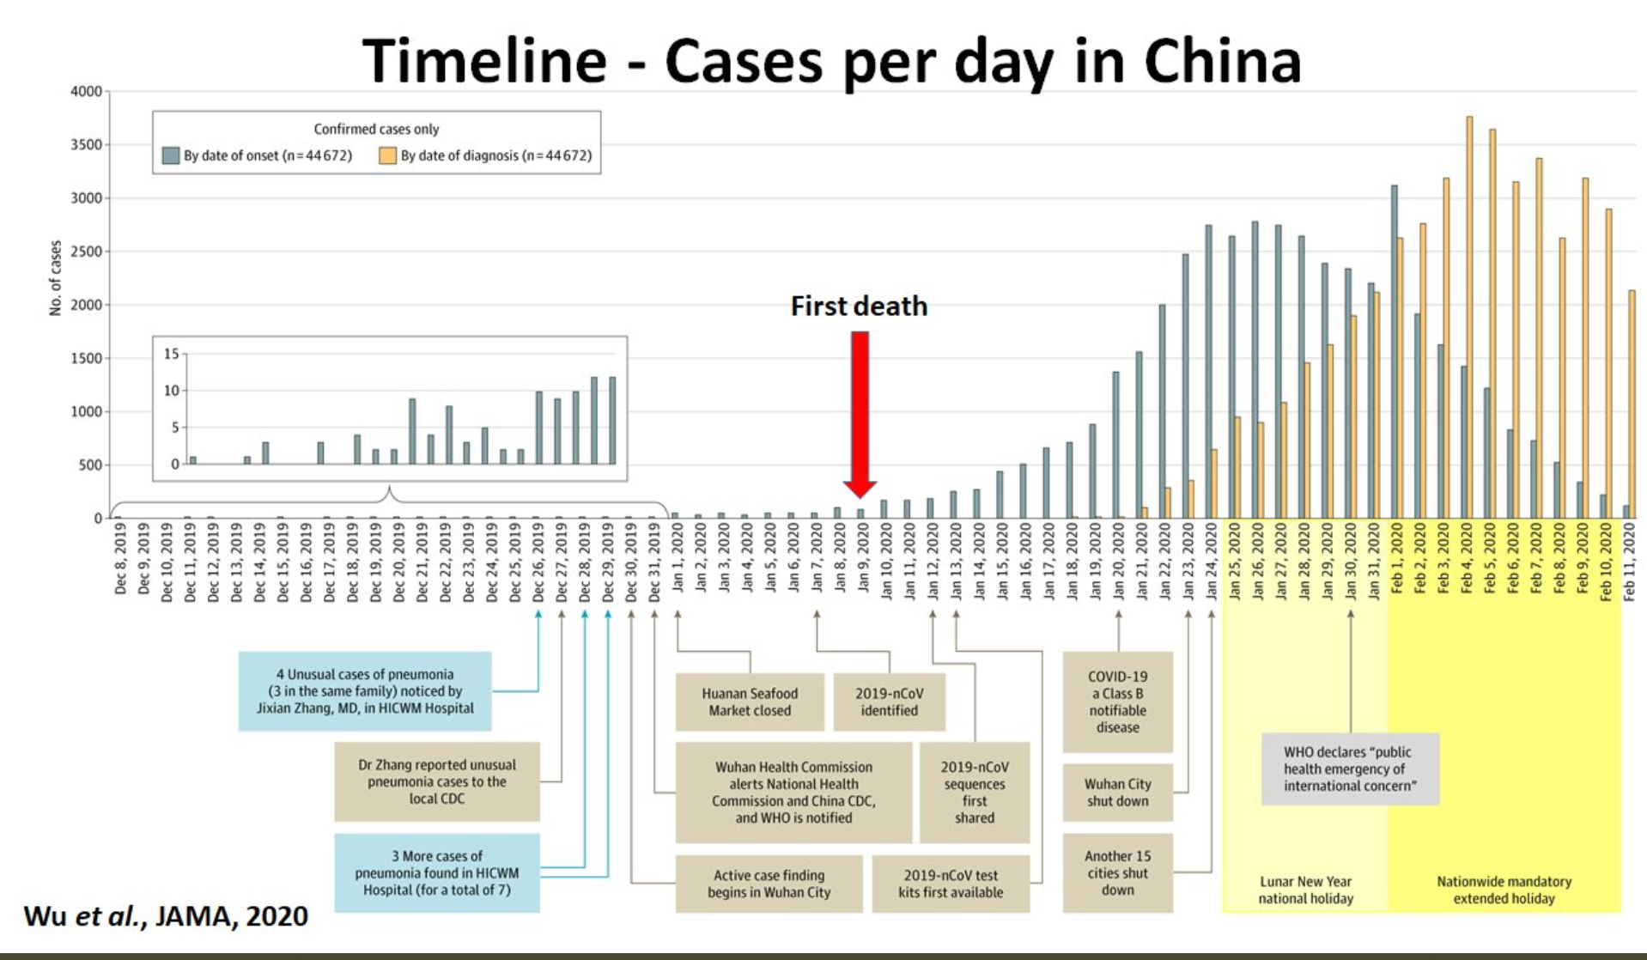
What We Think Happened in Wuhan
Wuhan beat it quickly—we think
Shut down Wuhan when there were 200 cases per day
Seems to have been a good choice
audio time

Slide 7
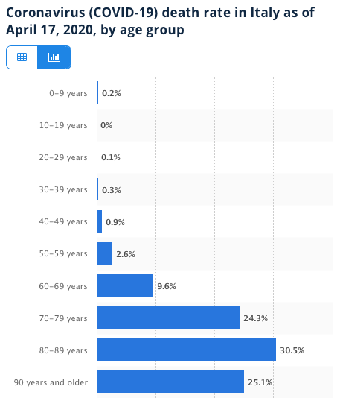
Death for Geezers!
Mortality for the Youngs low…
It can be a (very bad) flu for them—for you students…
Morbidity…
For olders: 3% in your 50s, 9% in your 60s
And a doubling—or is it 5%?—mortality for the asthmatic
And a doubling—or is it 5%?—mortality for the overweight
And an extra ???? if you have high blood pressure
And an extra ???? if you have high blood sugar
audio time

Slide 8
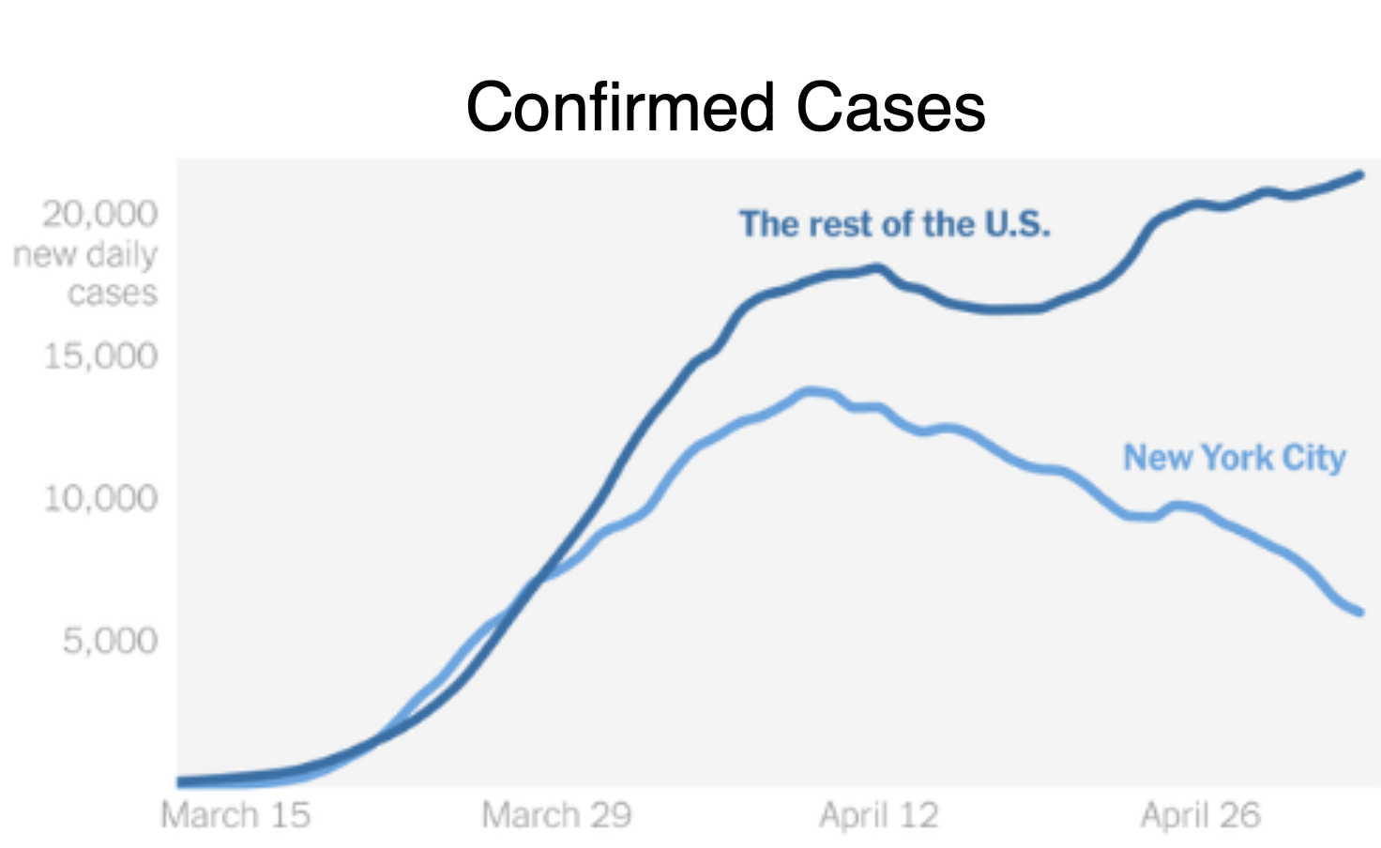
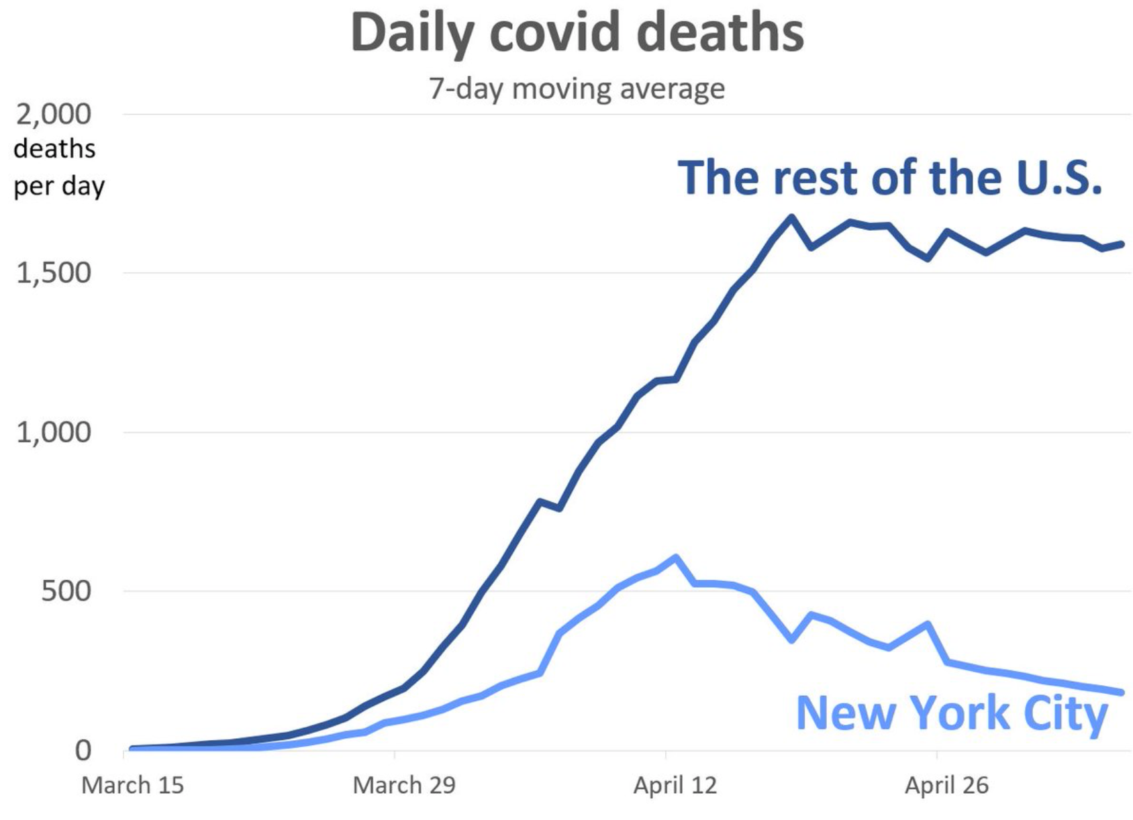
Separating New York City
New York City is well past its first epidemic peak:
The rest of the country is not
Perhaps 20% of the population of New York City has been brushed by the virus
Perhaps 2.5% of the country has been brushed by the virus
“Reopening” elsewhere will produce a lot of bad stuff
audio time

Slide 9
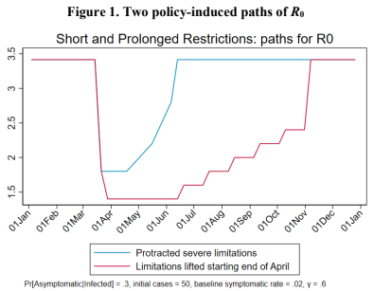
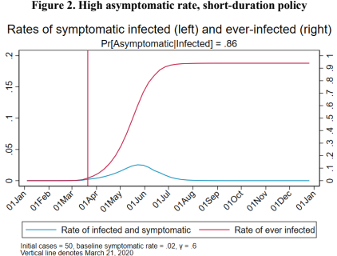
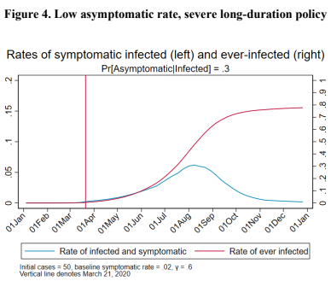
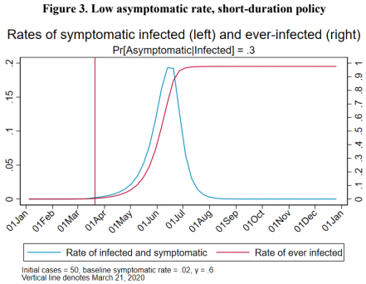
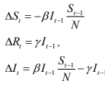
Integrating Public Health with Economics
Best thing I have read, still:
Comes from Jim Stock <https://www.jimstock.org>
Jim Stock: Coronavirus Data Gaps and the Policy Response <https://drive.google.com/file/d/12MV466ZZy5xHir4xdPhoTrL1oO8CbZU-/view>:
The basic SIR epidemiological model of contagion
What policy should be hinges on the coronavirus non-testing rate
Estimates in the epidemiological literature range from 0.18 to 0.86.
That is a case-catching rate of no less than 1/7—half of what extrapolations from 1% suggest
Does that mean we are dealing with a 2% virus?
audio time

Slide 10
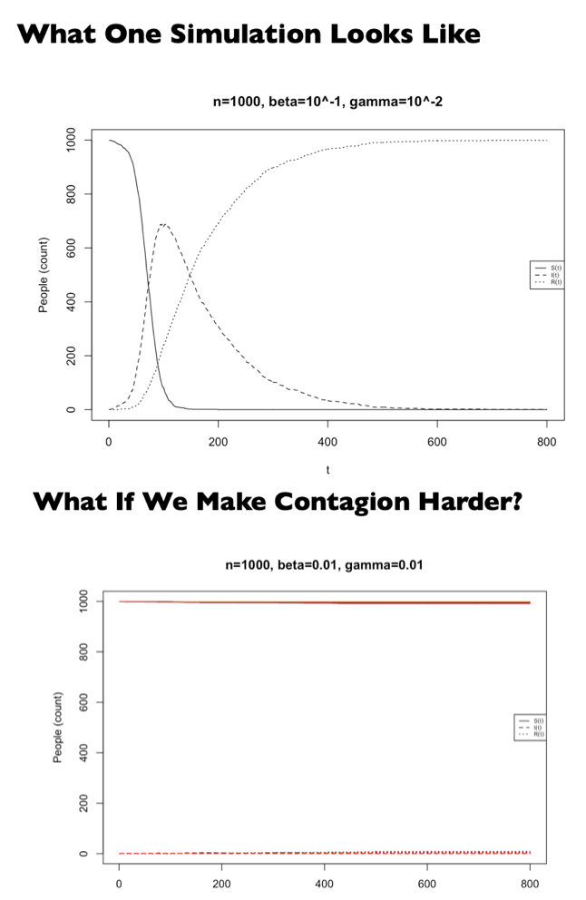
Second Best: Epidemic Models
A requested special topic:
Written and presented by Cosma Shalizi
Of Carnegie-Mellon University
<http://www.stat.cmu.edu/~cshalizi/dm/20/lectures/special/epidemics.html#(1)>
36-462/662, Spring 2020
16 April 2020 (Lecture 25)
audio time :: From Cosma Shalizi of Carnegie-Mellon: <http://www.stat.cmu.edu/~cshalizi/dm/20/lectures/special/epidemics.html#(1)>

Slide 11
Bringing the Economy Back Up from Anæsthesia
Major issues:
Certificates of immunity:
Which requires test, test, test:
And not just disease virus tests
Presence-of-antibodies tests
How quickly can we match the immune with public-contact jobs?
What jobs can be done with minimal infection risk?
What minimal-infection substitutes can we find for previous jobs?
How quickly can restrictions be relaxed without the virus coming roaring back?
How do we avoid having the market give a “shutdown” signal to enterprises we in fact want restarted?
Which is pretty much all of them
How much of the potential caseload do we want to push out beyond the vaccine-arrival date?
ALL THESE QUESTIONS ARE ANSWERABLE IF WE LEARN THE ASYMPTOMATIC HENCE NON-TESTED RATE!!
audio time

Slide 12
Keeping the Economy from Crashing During the Lockdown
Nick Rowe: We have a 50% output cut in 100% of the sectors:
A temporary 100% output cut in 50% of the sectors (what the Coronavirus does) is very different from a 50% output cut in 100% of the sectors
Nick’s thought experiment:
In three months we are going to invent unobtanium:
Substantial intertemporal substitutibility
Plus lower cross-good contemporaneous substitutitbility
Hence high desired savings rate now
Flex-price market thus produces a nominal rate at the zero lower bound and a high inflation rate over the next three to six months
Plus liquidity-constrained workers in affected sectors see their demand go to zero immediately
Can we get there? Should we get there? What should we do instead?
We need a good RBC economist: are there any?…
<https://worthwhile.typepad.com/worthwhile_canadian_initi/2020/03/relative-supply-shocks-unobtainium-walras-law-and-the-coronavirus.html>
audio time

Slide 13
Keeping the Economy from Crashing During the Lockdown II
Nick Rowe:
<https://worthwhile.typepad.com/worthwhile_canadian_initi/2020/03/relative-supply-shocks-unobtainium-walras-law-and-the-coronavirus.html>
Plus: to extend the thought experiment:
We just lost the ability to make “unobtainium”
So we should be substituting leisure for work, and moving workers into relatively unproductive labor, making the commodities we can still produce right now
How should relative prices move as a result? How should we make them move?
Plus: distributional issues
Plus: bankruptcy and credit chain issues
audio time

Slide 14
References
Directly cited here:
Financial Times (2020): Coronavirus Tracked: The Latest Figures as the Pandemic Spreads <https://www.ft.com/coronavirus-latest>
Nick Rowe (2020): Relative Supply Shocks, Unobtainium, Walras' Law, and the Coronavirus <https://worthwhile.typepad.com/worthwhile_canadian_initi/2020/03/relative-supply-shocks-unobtainium-walras-law-and-the-coronavirus.html>
Jim Stock (2020): Coronavirus Data Gaps and the Policy Response <https://drive.google.com/file/d/12MV466ZZy5xHir4xdPhoTrL1oO8CbZU-/view>
What I am watching:
Jim Stock (2020): Coronavirus Data Gaps and the Policy Response <https://drive.google.com/file/d/12MV466ZZy5xHir4xdPhoTrL1oO8CbZU-/view>
Max Roser & Hannah Ritchie: Coronavirus Disease (COVID-19) <https://ourworldindata.org/coronavirus>…
Worldometer: Coronavirus Update (Live) <https://www.worldometers.info/coronavirus/>…
FT Coronavirus Tracker <https://www.ft.com/content/a26fbf7e-48f8-11ea-aeb3-955839e06441>
Josh Marshall’s COVID Twitter List <https://twitter.com/i/lists/1233998285779632128>
NEJM Group: Updates on the Covid-19 Pandemic <http://m.n.nejm.org/nl/jsp/m.jsp?c=%40kxNtXckRDOq8oG0jJvAXsIzN4mPECIPhltxoTSdTU9k%3D&cid=DM89089_NEJM_COVID-19_Newsletter&bid=173498255>: 'From the New England Journal of Medicine, NEJM Journal Watch, NEJM Catalyst, and other trusted sources...
audio time

Slide 15
Catch Our Breath…
Continue the Discussion:
Ask a couple of questions?
Make a couple of comments?
Any more readings to recommend?
Files:
<https://www.icloud.com/keynote/0YKEi7HeOrVGvKYtt9FEqH7nA>
<https://www.bradford-delong.com/2020/04/coronavirus.html>
github:<https://github.com/braddelong/public-files/blob/master/coronavirus.pptx>
https://github.com/braddelong/public-files/blob/master/coronavirus.pdf>
html file: <https://www.bradford-delong.com/2020/04/coronavirus.html>
html edit: <https://www.typepad.com/site/blogs/6a00e551f08003883400e551f080068834/post/6a00e551f080038834025d9b3bd66a200c/edit>
<https://delong.typepad.com/files/2020-04-01-coronavirus.pdf>
audio time

Slide 16
Notes

Slide 17
Where We Think We Are with Coronavirus ARCHIVE
Brad DeLong
2020-04-18
< https://www.icloud.com/keynote/0YKEi7HeOrVGvKYtt9FEqH7nA>
<https://github.com/braddelong/public-files/blob/master/coronavirus.pptx>

Slide 18
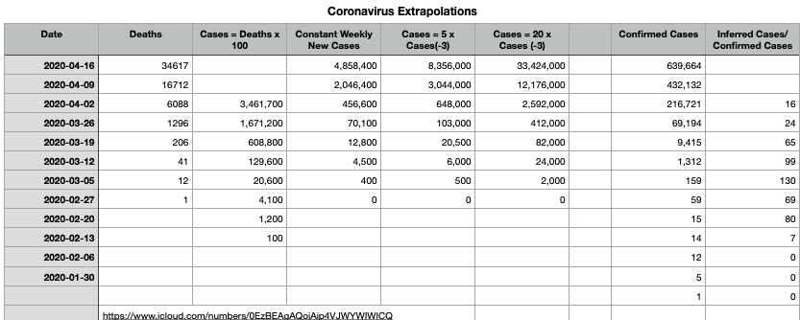
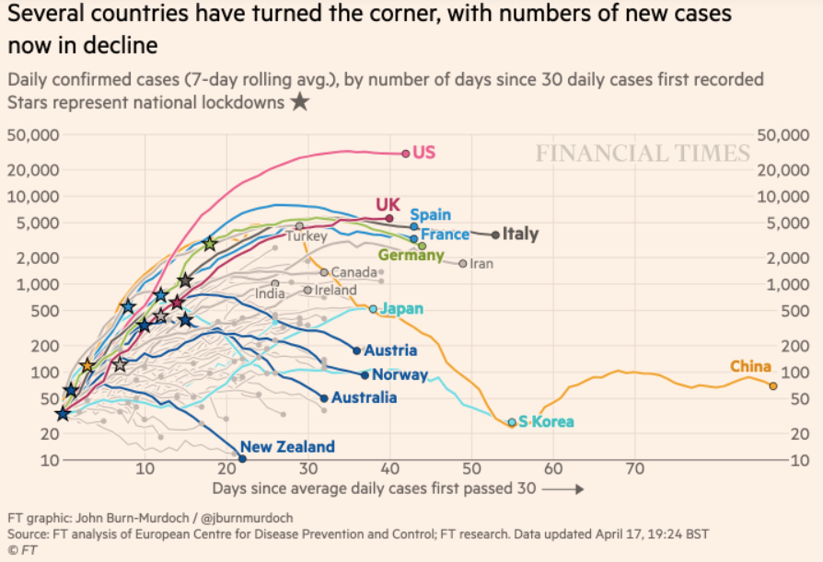
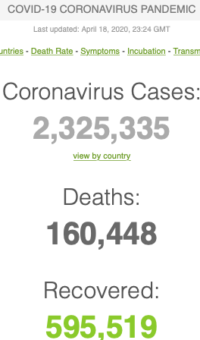
Where We Think We Are with Coronavirus 2020-04-20
Where we think we are, as of Mo Apr 20 2020:
We really do not know: no random samples…
If 1% recorded mortality from virus brushing close enough to confer temporary immunity…
And if two weeks from diagnosis to death…
Then U.S. in late March was catching one in fifteen cases
And if that still holds, than 12 million people in the U.S. have or have had the disease
And 500,000 are catching it and gaining at least temporary immunity every day out the past week straight-line log:
The U.S. flattened but not bent down the curve:
R[0] = 1
2500 recorded deaths/day
True mortality probably twice as high
2.3 million total confirmed cases worldwide; 160 thousand confirmed dead…
audio time

Slide 21
Integrating Public Health with Economics
Best thing I have read:
Comes from Jim Stock <https://www.jimstock.org>
Jim Stock: Coronavirus Data Gaps and the Policy Response <https://drive.google.com/file/d/12MV466ZZy5xHir4xdPhoTrL1oO8CbZU-/view>:
The basic SIR epidemiological model of contagion
What policy should be hinges on the coronavirus non-testing rate
Estimates in the epidemiological literature range from 0.18 to 0.86.
That is a case-catching rate of no less than 1/7—half of what extrapolations from 1% suggest
Does that mean we are dealing with a 2% virus?
audio time

Slide 27
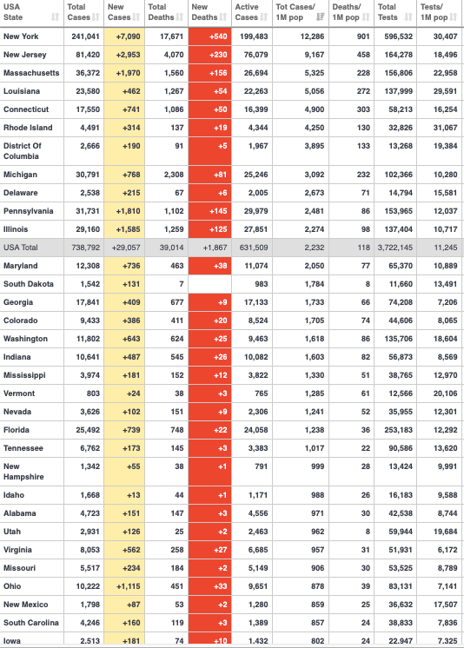
Most Afflicted States
40% of all cases in NY-NJ-CT:
Other hot spots:
MA-RI (Biogen)
LA (Mardi Gras)
DC
MI
But it looks like others will be coming up fast…
As of 2020-
audio time

Slide 31
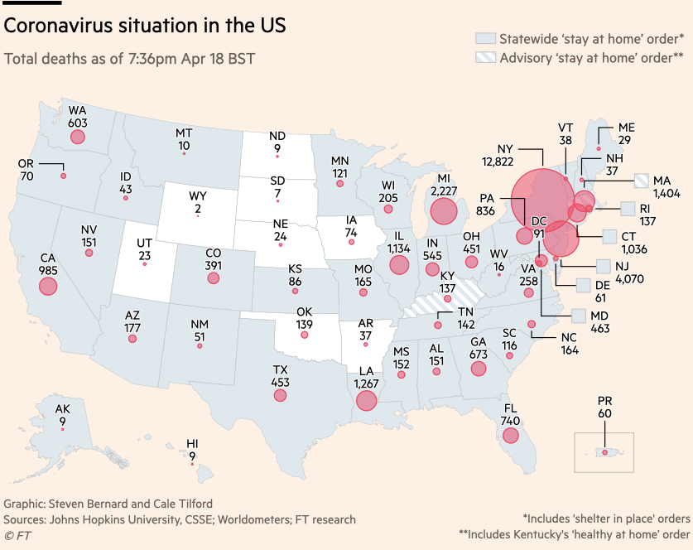

Slide 32
Bringing the Economy Back Up from Anæsthesia
Major issues:
Certificates of immunity:
Which requires test, test, test:
And not just disease virus tests
Presence-of-antibodies tests
How quickly can we match the immune with public-contact jobs?
What jobs can be done with minimal infection risk?
What minimal-infection substitutes can we find for previous jobs?
How quickly can restrictions be relaxed without the virus coming roaring back?
How do we avoid having the market give a “shutdown” signal to enterprises we in fact want restarted?
Which is pretty much all of them
How much of the potential caseload do we want to push out beyond the vaccine-arrival date?
ALL THESE QUESTIONS ARE ANSWERABLE IF WE LEARN THE ASYMPTOMATIC HENCE NON-TESTED RATE!!
audio time

Slide 33
Keeping the Economy from Crashing During the Lockdown
Nick Rowe: We have a 50% output cut in 100% of the sectors:
A temporary 100% output cut in 50% of the sectors (what the Coronavirus does) is very different from a 50% output cut in 100% of the sectors
Nick’s thought experiment:
In three months we are going to invent unobtanium:
Substantial intertemporal substitutibility
Plus lower cross-good contemporaneous substitutitbility
Hence high desired savings rate now
Flex-price market thus produces a nominal rate at the zero lower bound and a high inflation rate over the next three to six months
Plus liquidity-constrained workers in affected sectors see their demand go to zero immediately
Can we get there? Should we get there? What should we do instead?
We need a good RBC economist: are there any?…
<https://worthwhile.typepad.com/worthwhile_canadian_initi/2020/03/relative-supply-shocks-unobtainium-walras-law-and-the-coronavirus.html>
audio time

Slide 34
Keeping the Economy from Crashing During the Lockdown II
Nick Rowe:
<https://worthwhile.typepad.com/worthwhile_canadian_initi/2020/03/relative-supply-shocks-unobtainium-walras-law-and-the-coronavirus.html>
Plus: to extend the thought experiment:
We just lost the ability to make “unobtainium”
So we should be substituting leisure for work, and moving workers into relatively unproductive labor, making the commodities we can still produce right now
How should relative prices move as a result? How should we make them move?
Plus: distributional issues
Plus: bankruptcy and credit chain issues
audio time

Slide 35
MOAR Coronavirus!
Death for Geezers!
Mortality for the Youngs very low…
It’s the flu for them—for you…
For the olders:
And an extra doubling—or is it 5%?—mortality for the asthmatic
And an extra doubling—or is it 5%?—mortality for the overweight
And an extra ???? if you have high blood pressure
And an extra ???? if you have high blood sugar
audio time

Slide 36
What We Think Happened in Wuhan
Wuhan beat it quickly—we think
Shut down Wuhan when there were 200 cases per day
Seems to have been a good choice
audio time

Slide 37
References
Directly cited here:
Financial Times (2020): Coronavirus Tracked: The Latest Figures as the Pandemic Spreads <https://www.ft.com/coronavirus-latest>
Nick Rowe (2020): Relative Supply Shocks, Unobtainium, Walras' Law, and the Coronavirus <https://worthwhile.typepad.com/worthwhile_canadian_initi/2020/03/relative-supply-shocks-unobtainium-walras-law-and-the-coronavirus.html>
Jim Stock (2020): Coronavirus Data Gaps and the Policy Response <https://drive.google.com/file/d/12MV466ZZy5xHir4xdPhoTrL1oO8CbZU-/view>
What I am watching:
Jim Stock (2020): Coronavirus Data Gaps and the Policy Response <https://drive.google.com/file/d/12MV466ZZy5xHir4xdPhoTrL1oO8CbZU-/view>
Max Roser & Hannah Ritchie: Coronavirus Disease (COVID-19) <https://ourworldindata.org/coronavirus>…
Worldometer: Coronavirus Update (Live) <https://www.worldometers.info/coronavirus/>…
FT Coronavirus Tracker <https://www.ft.com/content/a26fbf7e-48f8-11ea-aeb3-955839e06441>
Josh Marshall’s COVID Twitter List <https://twitter.com/i/lists/1233998285779632128>
NEJM Group: Updates on the Covid-19 Pandemic <http://m.n.nejm.org/nl/jsp/m.jsp?c=%40kxNtXckRDOq8oG0jJvAXsIzN4mPECIPhltxoTSdTU9k%3D&cid=DM89089_NEJM_COVID-19_Newsletter&bid=173498255>: 'From the New England Journal of Medicine, NEJM Journal Watch, NEJM Catalyst, and other trusted sources...
audio time

Slide 38
Catch Our Breath…
Continue the Discussion:
Ask a couple of questions?
Make a couple of comments?
Any more readings to recommend?
Files:
<https://www.icloud.com/keynote/0YKEi7HeOrVGvKYtt9FEqH7nA>
<https://www.bradford-delong.com/2020/04/coronavirus.html>
github:<https://github.com/braddelong/public-files/blob/master/coronavirus.pptx>
https://github.com/braddelong/public-files/blob/master/coronavirus.pdf>
html file: <https://www.bradford-delong.com/2020/04/coronavirus.html>
html edit: <https://www.typepad.com/site/blogs/6a00e551f08003883400e551f080068834/post/6a00e551f080038834025d9b3bd66a200c/edit>
<https://delong.typepad.com/files/2020-04-01-coronavirus.pdf>
audio time

Slide 39
Notes

Slide 40
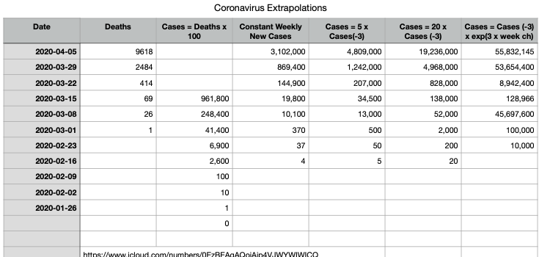
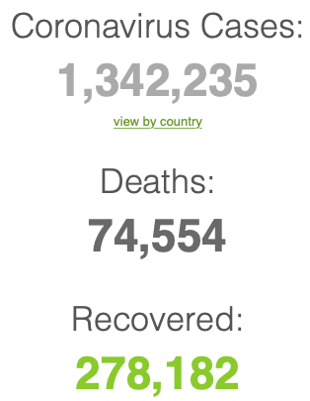
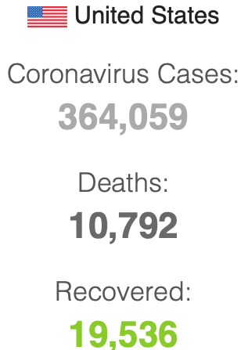
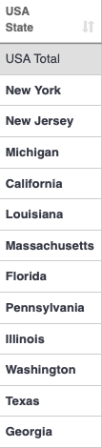
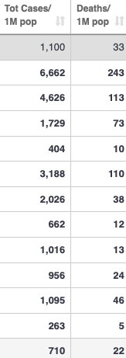
2020-04-06 Coronavirus
Where we think we are, as of Mo Apr 6:
We really do not know
No random samples…
If we extrapolate out the past week straight-line log:
We will have 440,000 deaths in three weeks
But it is unlikely to be that bad
Best thing I have read comes from Jim Stock <https://drive.google.com/file/d/12MV466ZZy5xHir4xdPhoTrL1oO8CbZU-/view>:
The basic SIR epidemiological model of contagion
The effect of social distancing and business shutdowns on epidemic dynamics enters the model through a single parameter: the case transmission rate β
Re-express the model in terms of β and the asymptomatic (or not very symptomatic) hence non-tested rate—the fraction of the infected who are not tested
The COVID-19 non-testing rate is unidentified in our model
Estimates in the epidemiological literature range from 0.18 to 0.86.
The asymptomatic rate could be estimated accurately and quickly by testing a random sample
The optimal policy response and its economic consequences hinge critically on the asymptomatic rate

Slide 41
Coronavirus II
We do not really know where we are, as of Mo Apr 6:
Best thing I have read comes from Jim Stock <https://drive.google.com/file/d/12MV466ZZy5xHir4xdPhoTrL1oO8CbZU-/view>:
The basic SIR epidemiological model of contagion
The effect of social distancing and business shutdowns on epidemic dynamics enters the model through a single parameter: the case transmission rate β
Re-express the model in terms of β and the asymptomatic (or not very symptomatic) hence non-tested rate—the fraction of the infected who are not tested
The COVID-19 non-testing rate is unidentified in our model
Estimates in the epidemiological literature range from 0.18 to 0.86.
The asymptomatic rate could be estimated accurately and quickly by testing a random sample
The optimal policy response and its economic consequences hinge critically on the asymptomatic rate

Slide 45
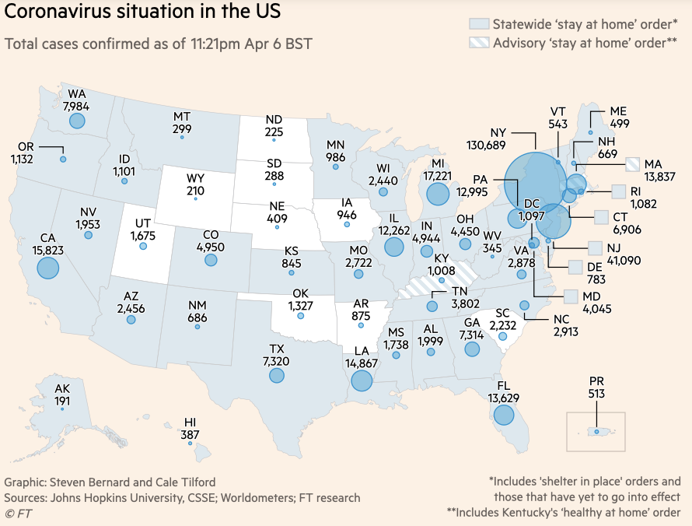
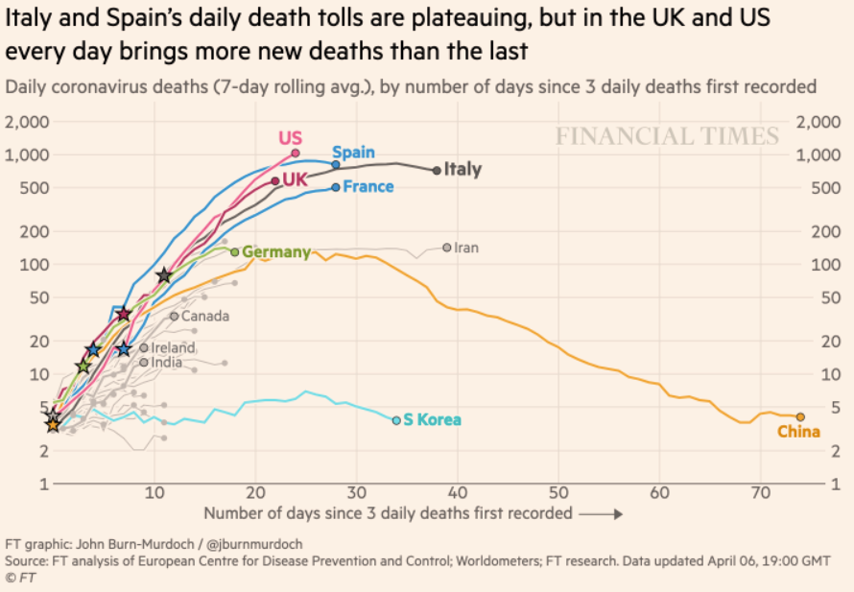
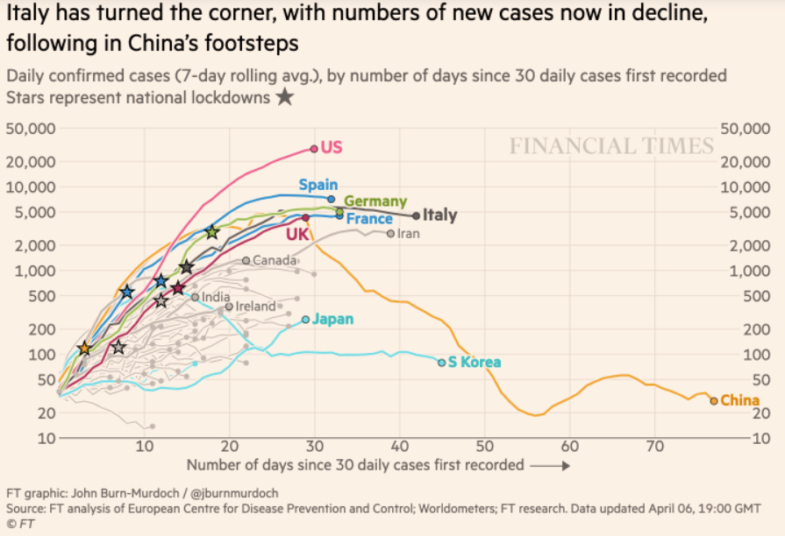
Financial Times Graphs Blown Up…

Slide 49
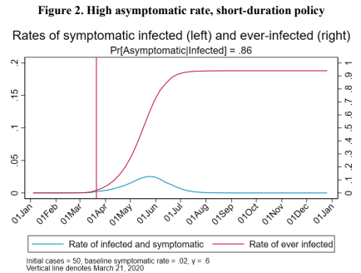
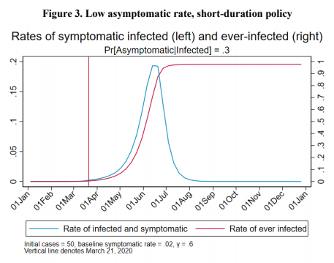
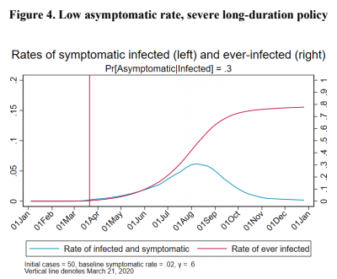
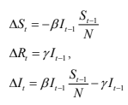
James Stock (2020)
Standard SIR model:<https://drive.google.com/file/d/12MV466ZZy5xHir4xdPhoTrL1oO8CbZU-/view>:
Susceptible, Infected, Recovered (& immune), transmission rate β, recovery rate γ, reproduction number R0, asymptomatic hence non-tested rate π0
Calibration: half-life of infection one week: γ = 0.5, s0 = 0.02, 50 cases on Jan 24
For March 21, 2020, the positive test rate in the United States is approximately 10%…
<https://drive.google.com/file/d/12MV466ZZy5xHir4xdPhoTrL1oO8CbZU-/view>

Slide 54
Bringing the Economy Back Up from Anæsthesia
Major issues:
Certificates of immunity:
Which requires test, test, test:
And not just disease virus tests
Presence-of-antibodies tests
How quickly can we match the immune with public-contact jobs?
What jobs can be done with minimal infection risk?
What minimal-infection substitutes can we find for previous jobs?
How quickly can restrictions be relaxed without the virus coming roaring back?
How do we avoid having the market give a “shutdown” signal to enterprises we in fact want restarted?
Which is pretty much all of them
How much of the potential caseload do we want to push out beyond the vaccine-arrival date?
ALL THESE QUESTIONS ARE ANSWERABLE IF WE LEARN THE ASYMPTOMATIC HENCE NON-TESTED RATE!!

Slide 55
Keeping the Economy from Crashing During the Lockdown
Nick Rowe: We have a 50% output cut in 100% of the sectors:
A temporary 100% output cut in 50% of the sectors (what the Coronavirus does) is very different from a 50% output cut in 100% of the sectors
Nick’s thought experiment:
In three months we are going to invent unobtanium:
Substantial intertemporal substitutibility
Plus lower cross-good contemporaneous substitutitbility
Hence high desired savings rate now
Flex-price market thus produces a nominal rate at the zero lower bound and a high inflation rate over the next three to six months
Plus liquidity-constrained workers in affected sectors see their demand go to zero immediately
Can we get there? Should we get there? What should we do instead?
We need a good RBC economist: are there any?…
<https://worthwhile.typepad.com/worthwhile_canadian_initi/2020/03/relative-supply-shocks-unobtainium-walras-law-and-the-coronavirus.html>

Slide 56
Keeping the Economy from Crashing During the Lockdown II
Nick Rowe:
<https://worthwhile.typepad.com/worthwhile_canadian_initi/2020/03/relative-supply-shocks-unobtainium-walras-law-and-the-coronavirus.html>
Plus: to extend the thought experiment:
We just lost the ability to make “unobtainium”
So we should be substituting leisure for work, and moving workers into relatively unproductive labor, making the commodities we can still produce right now
How should relative prices move as a result? How should we make them move?
Plus: distributional issues
Plus: bankruptcy and credit chain issues

Slide 57
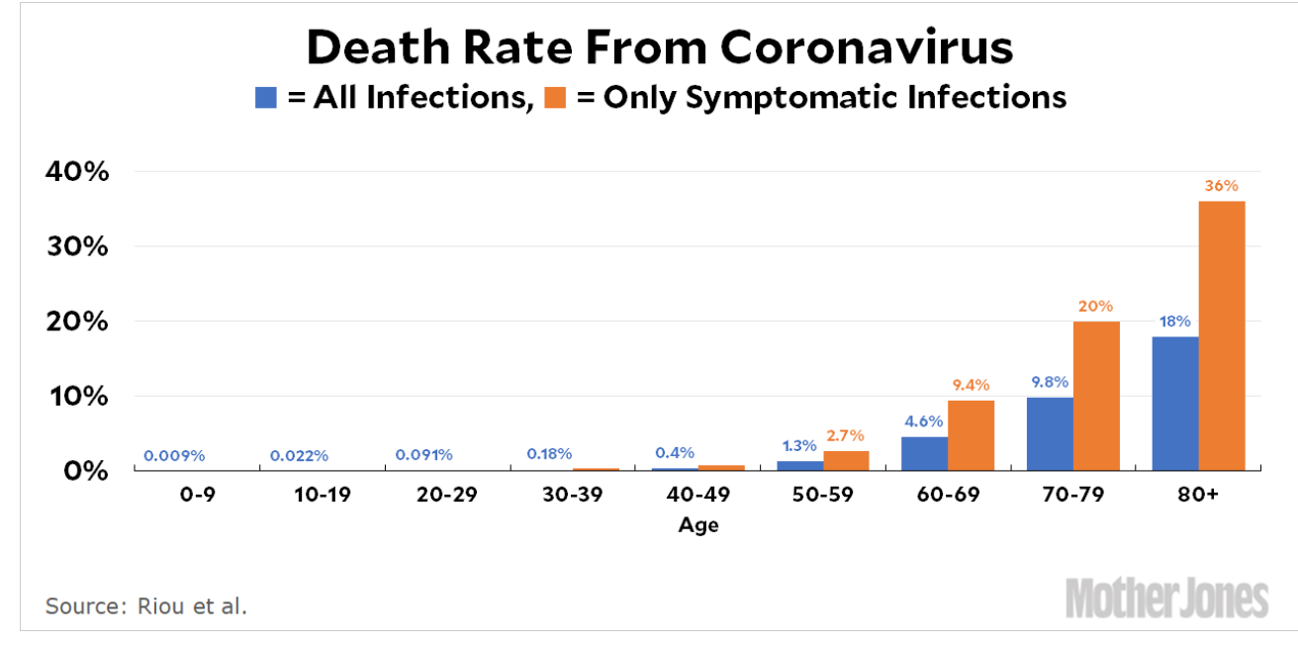
MOAR Coronavirus!
Death for Geezers!
Mortality for the Youngs very low…
It’s the flu for them—for you…
And an extra doubling—or is it 5%?—mortality for the asthmatic
And an extra doubling—or is it 5%?—mortality for the overweight

Slide 58
What We Think Happened in Wuhan
China beat it quickly & relatively easily!
We think
Shut down Wuhan when 200 cases per day
That seems to have been a good decision

Slide 59
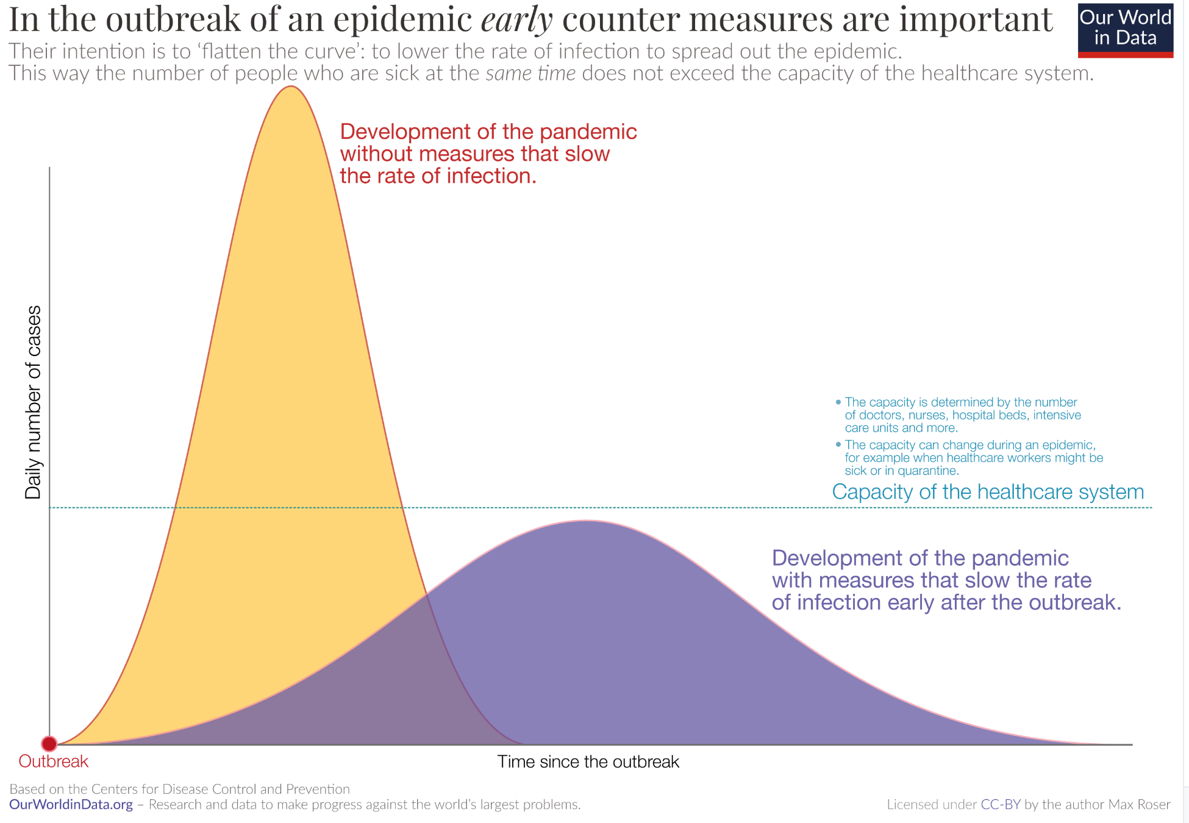
The Goal
When Is It Appropriate to Move on This?
Immediate social distancing…
Self-isolate if you have a cough and a fever…
Hope that warmer temperatures will do to this what they did to SARS…
Otherwise, when do you want to start spreading out transmission. It seems that early is as good as later, so do it early…
I have no good intuition on why you want to move early
Plus your moving early will be wasted if you get reinfected
Plus the sparks you throw off making others’ lives more difficult

Slide 60
References
Financial Times (2020): Coronavirus Tracked: The Latest Figures as the Pandemic Spreads <https://www.ft.com/coronavirus-latest>
Nick Rowe (2020): Relative Supply Shocks, Unobtainium, Walras' Law, and the Coronavirus <https://worthwhile.typepad.com/worthwhile_canadian_initi/2020/03/relative-supply-shocks-unobtainium-walras-law-and-the-coronavirus.html>
Jim Stock (2020): Coronavirus Data Gaps and the Policy Response <https://drive.google.com/file/d/12MV466ZZy5xHir4xdPhoTrL1oO8CbZU-/view>

Slide 61
MOAR Coronavirus!
What I am watching:
Max Roser & Hannah Ritchie: Coronavirus Disease (COVID-19) <https://ourworldindata.org/coronavirus>…
Worldometer: Coronavirus Update (Live) <https://www.worldometers.info/coronavirus/>: ‘125,599 Cases and 4,605 Deaths from COVID-19 Virus Outbreak…
FT Coronavirus Tracker <https://www.ft.com/content/a26fbf7e-48f8-11ea-aeb3-955839e06441>
Josh Marshall’s COVID Twitter List <https://twitter.com/i/lists/1233998285779632128>
NEJM Group: Updates on the Covid-19 Pandemic <http://m.n.nejm.org/nl/jsp/m.jsp?c=%40kxNtXckRDOq8oG0jJvAXsIzN4mPECIPhltxoTSdTU9k%3D&cid=DM89089_NEJM_COVID-19_Newsletter&bid=173498255>: 'From the New England Journal of Medicine, NEJM Journal Watch, NEJM Catalyst, and other trusted sources...

Slide 62
Catch Our Breath…
Ask a couple of questions?
Make a couple of comments?
Any more readings to recommend?
<https://www.icloud.com/keynote/0YKEi7HeOrVGvKYtt9FEqH7nA>
<https://www.bradford-delong.com/2020/04/coronavirus.html>
github:<https://github.com/braddelong/public-files/blob/master/coronavirus.pptx>
https://github.com/braddelong/public-files/blob/master/coronavirus.pdf>
html File: <https://www.bradford-delong.com/2020/04/coronavirus.html>
Edit This File: <https://www.typepad.com/site/blogs/6a00e551f08003883400e551f080068834/post/6a00e551f080038834025d9b3bd66a200c/edit>
<https://delong.typepad.com/files/2020-04-01-coronavirus.pdf>

Slide 63
Coronavirus! (March 16)
With 31 deaths in the U.S. as of March 11, a 1% death rate, and up to 4 weeks between infection and death, that means that as of Feb 12 there were 3100 coronavirus cases in the United States.
With 87 deaths in the U.S. as of Mar 16, a 1% death rate, and up to 4 weeks between infection and death, that means that as of Feb 17 there were 8700 coronavirus cases in the United States
If it is doubling every seven days, then now about 150,000 people have and in the next week about 150,000 more people in the U.S. will catch coronavirus—which means 1/2200, currently 3500 of the 7.6 million inhabitants of San Francisco Bay. Touch a hard surface that any of those 3500 has touched in the last 48 hours, and the virus has a chance to jump to you…
These numbers could be five times too big. These numbers are probably not five times too small unless the thing is a lot less deadly, and there are a lot of asymptomatic cases…
What is wrong with this analysis?

Slide 64
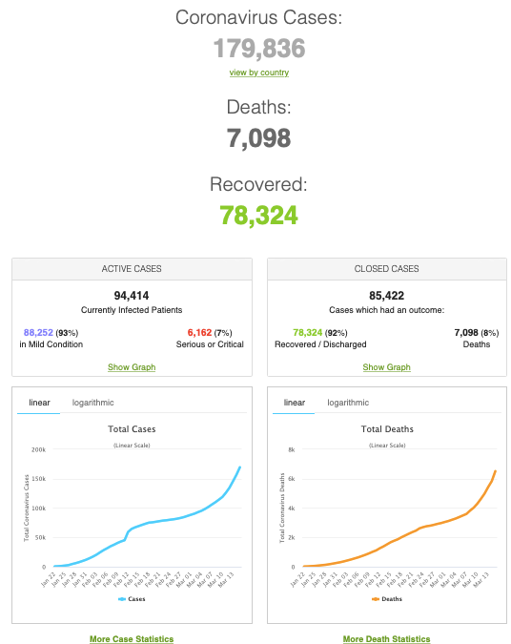
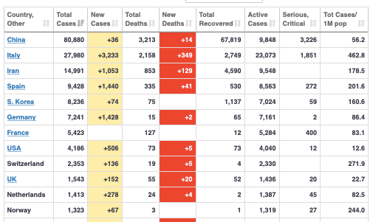
MOAR Coronavirus!
As of March 21: Things are not moving in the right direction:
What is the R0?
How can the R0 be changed?
How will the R0 change?
What is the asymptote share of the population?
What is the mortality rate?

Slide 65
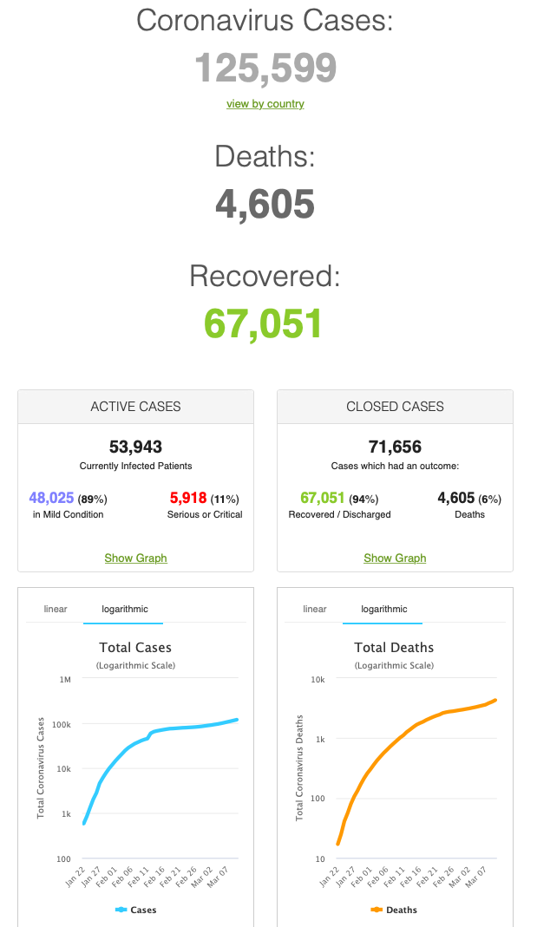
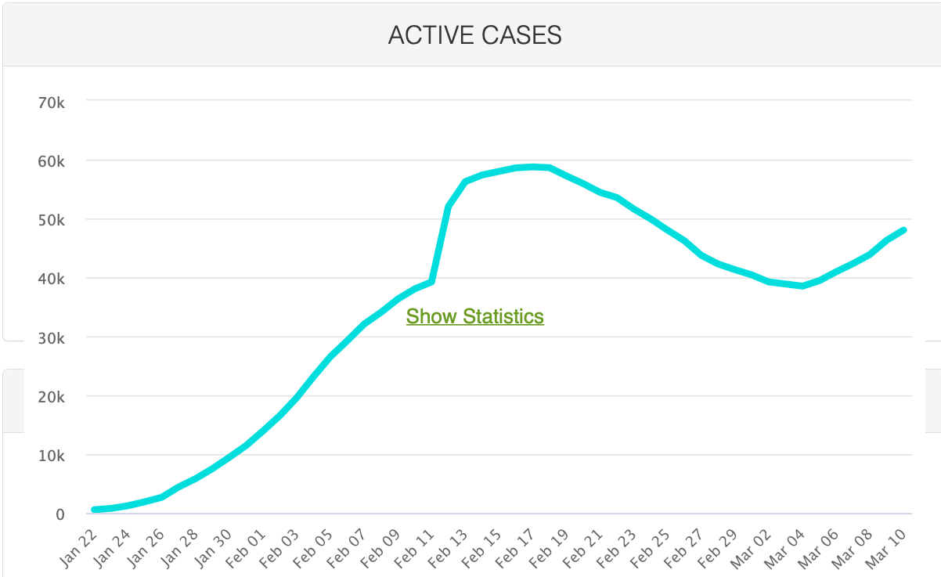
MOAR Coronavirus!
As of March 10: Things are not moving in the right direction:
What is the R0?
How can the R0 be changed?
How will the R0 change?
What is the asymptote share of the population?
What is the mortality rate?

Slide 66
Notes

Slide 67
Epidemic Models
A requested special topic:
Written and presented by Cosma Shalizi
Of Carnegie-Mellon University
<http://www.stat.cmu.edu/~cshalizi/dm/20/lectures/special/epidemics.html#(1)>
36-462/662, Spring 2020
16 April 2020 (Lecture 25)
audio time :: From Cosma Shalizi of Carnegie-Mellon: <http://www.stat.cmu.edu/~cshalizi/dm/20/lectures/special/epidemics.html#(1)>

Slide 68
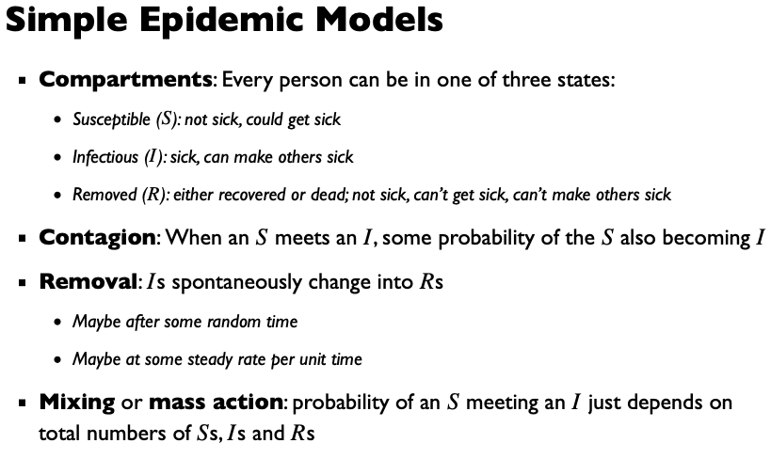
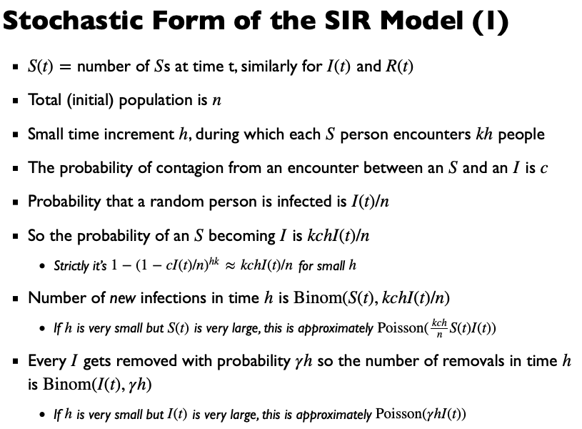
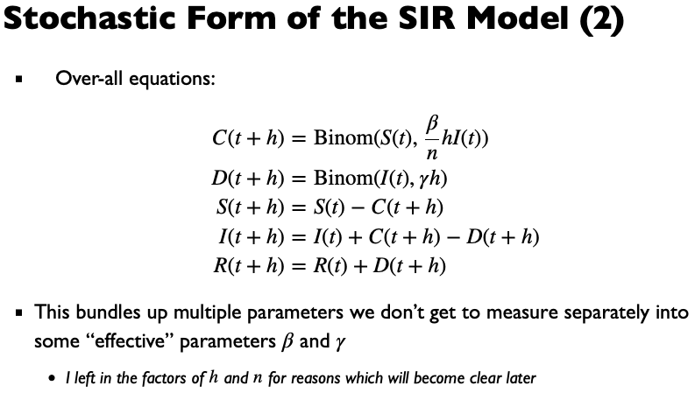
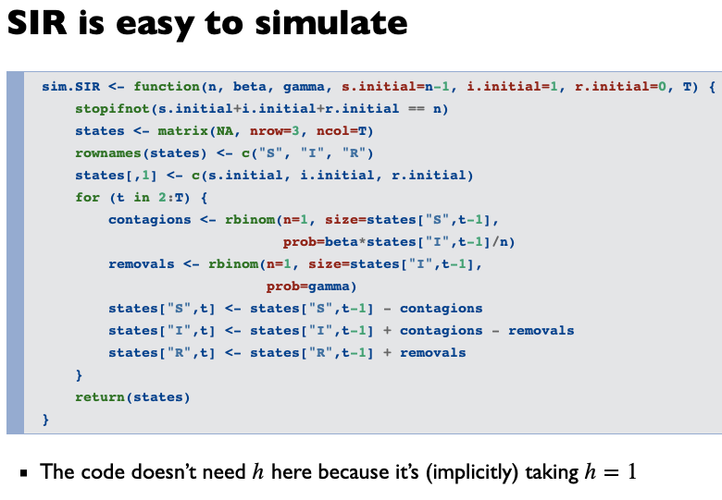
audio time :: From Cosma Shalizi of Carnegie-Mellon: <http://www.stat.cmu.edu/~cshalizi/dm/20/lectures/special/epidemics.html#(1)>

Slide 69
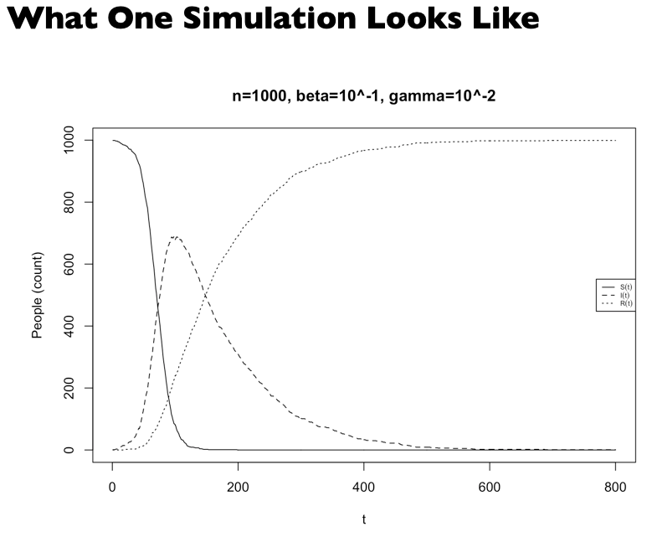
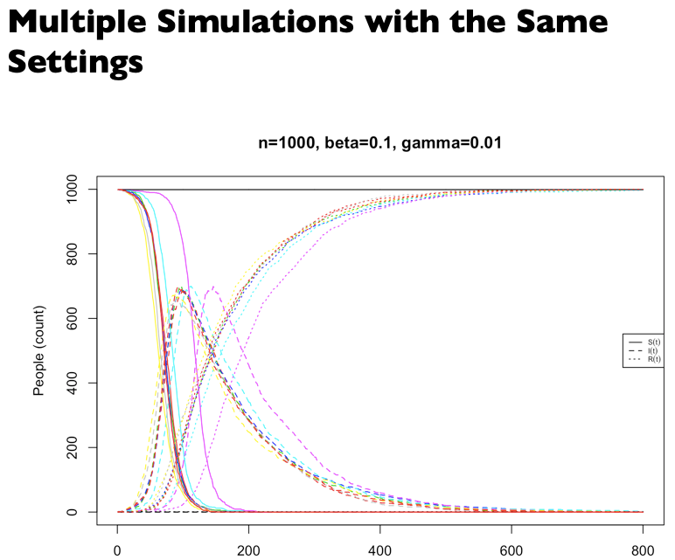
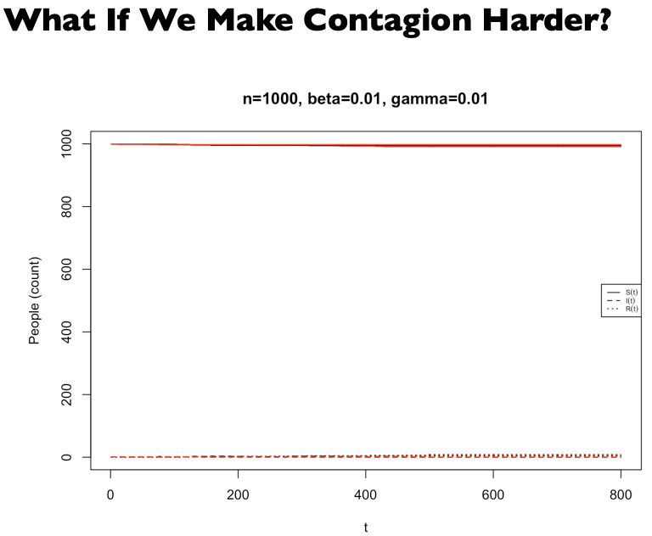
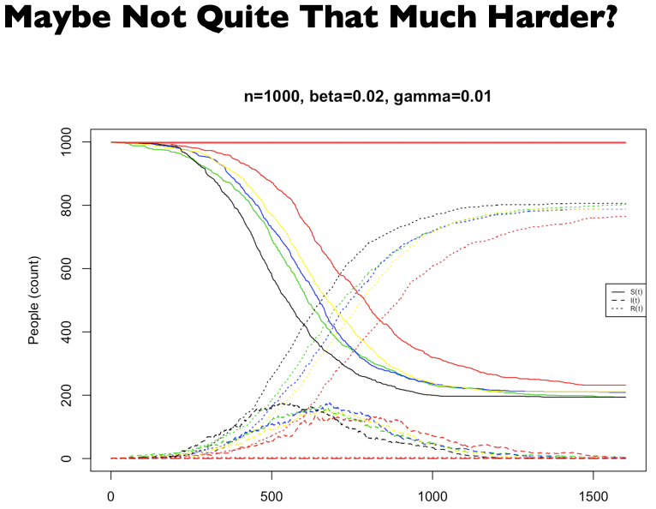
audio time :: From Cosma Shalizi of Carnegie-Mellon: <http://www.stat.cmu.edu/~cshalizi/dm/20/lectures/special/epidemics.html#(1)>

Slide 70
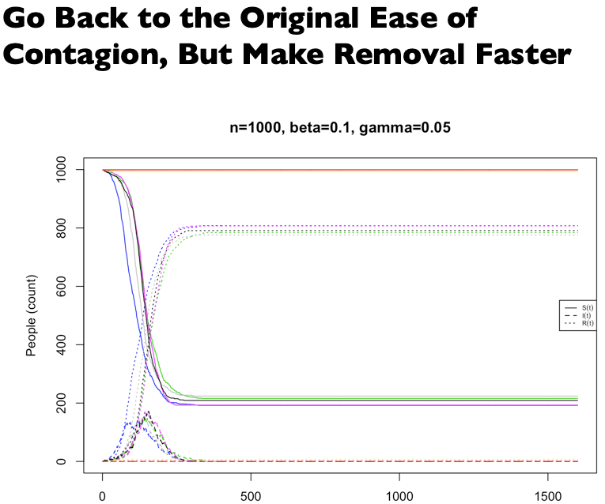
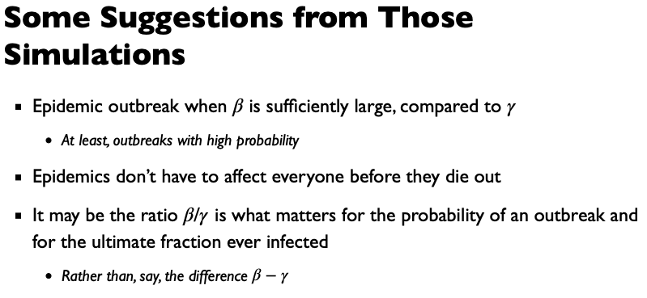
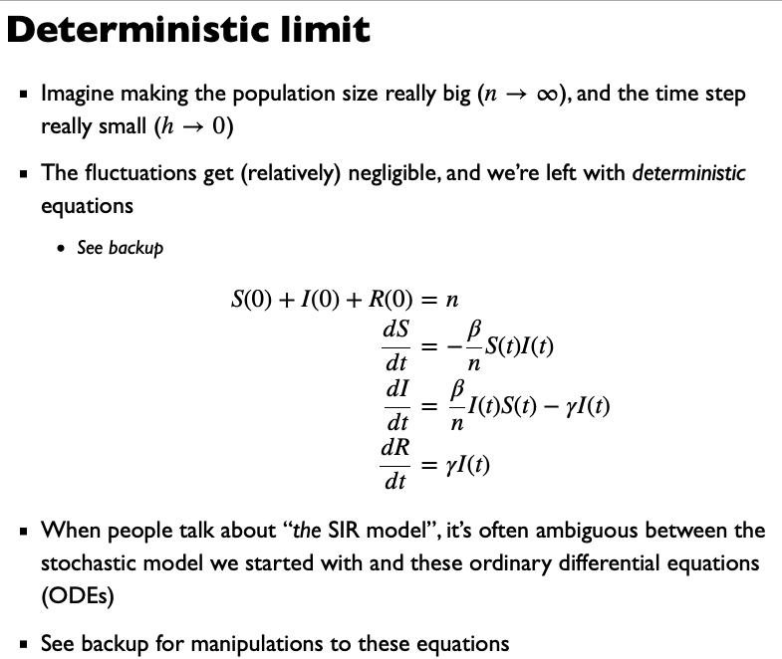
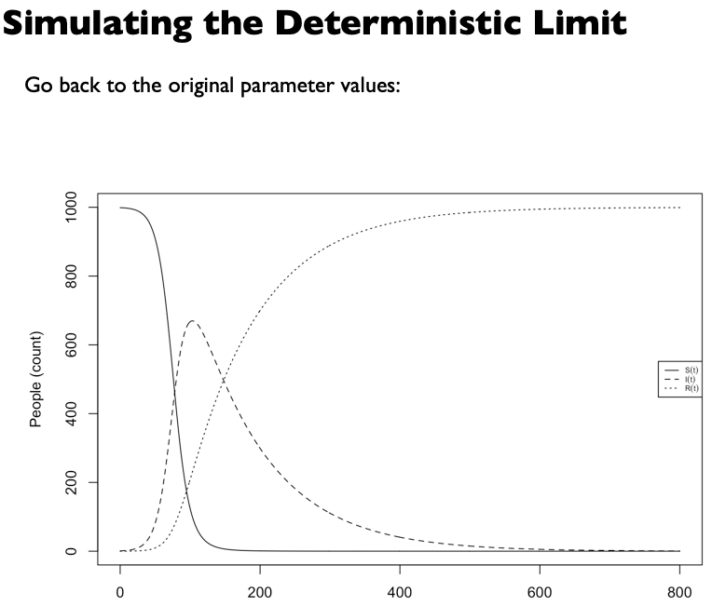
audio time :: From Cosma Shalizi of Carnegie-Mellon: <http://www.stat.cmu.edu/~cshalizi/dm/20/lectures/special/epidemics.html#(1)>

Slide 71
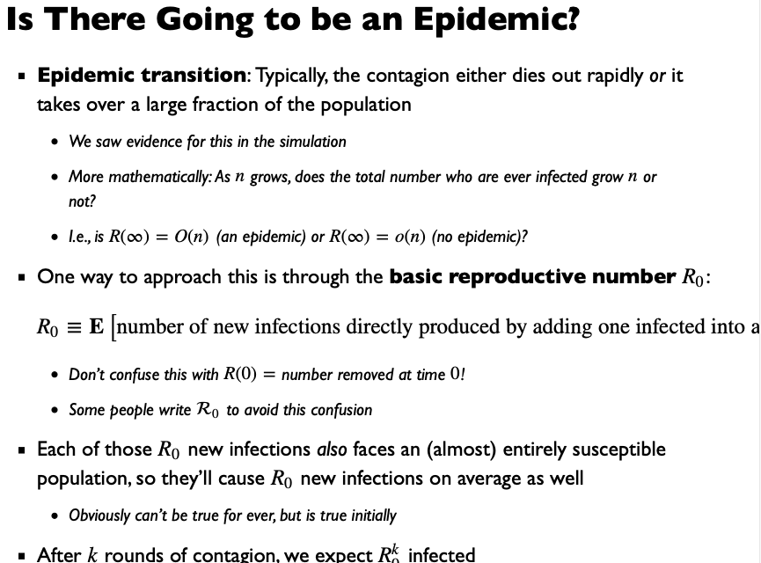



audio time :: From Cosma Shalizi of Carnegie-Mellon: <http://www.stat.cmu.edu/~cshalizi/dm/20/lectures/special/epidemics.html#(1)>

Slide 72





audio time :: From Cosma Shalizi of Carnegie-Mellon: <http://www.stat.cmu.edu/~cshalizi/dm/20/lectures/special/epidemics.html#(1)>

Slide 73




audio time :: From Cosma Shalizi of Carnegie-Mellon: <http://www.stat.cmu.edu/~cshalizi/dm/20/lectures/special/epidemics.html#(1)>

Slide 74




audio time :: From Cosma Shalizi of Carnegie-Mellon: <http://www.stat.cmu.edu/~cshalizi/dm/20/lectures/special/epidemics.html#(1)>

Slide 75



audio time :: From Cosma Shalizi of Carnegie-Mellon: <http://www.stat.cmu.edu/~cshalizi/dm/20/lectures/special/epidemics.html#(1)>

Slide 76







audio time :: From Cosma Shalizi of Carnegie-Mellon: <http://www.stat.cmu.edu/~cshalizi/dm/20/lectures/special/epidemics.html#(1)>

Slide 77


audio time :: From Cosma Shalizi of Carnegie-Mellon: <http://www.stat.cmu.edu/~cshalizi/dm/20/lectures/special/epidemics.html#(1)>

Slide 78

audio time :: From Cosma Shalizi of Carnegie-Mellon: <http://www.stat.cmu.edu/~cshalizi/dm/20/lectures/special/epidemics.html#(1)>

Slide 79


audio time :: From Cosma Shalizi of Carnegie-Mellon: <http://www.stat.cmu.edu/~cshalizi/dm/20/lectures/special/epidemics.html#(1)>

Slide 80
2020-04-06 Coronavirus
Where we think we are, as of Mo Apr 6:
We really do not know
No random samples…
If we extrapolate out the past week straight-line log:
We will have 440,000 deaths in three weeks
But it is unlikely to be that bad
Best thing I have read comes from Jim Stock <https://drive.google.com/file/d/12MV466ZZy5xHir4xdPhoTrL1oO8CbZU-/view>:
The basic SIR epidemiological model of contagion
The effect of social distancing and business shutdowns on epidemic dynamics enters the model through a single parameter: the case transmission rate β
Re-express the model in terms of β and the asymptomatic (or not very symptomatic) hence non-tested rate—the fraction of the infected who are not tested
The COVID-19 non-testing rate is unidentified in our model
Estimates in the epidemiological literature range from 0.18 to 0.86.
The asymptomatic rate could be estimated accurately and quickly by testing a random sample
The optimal policy response and its economic consequences hinge critically on the asymptomatic rate

Slide 81
Coronavirus II
We do not really know where we are, as of Mo Apr 6:
Best thing I have read comes from Jim Stock <https://drive.google.com/file/d/12MV466ZZy5xHir4xdPhoTrL1oO8CbZU-/view>:
The basic SIR epidemiological model of contagion
The effect of social distancing and business shutdowns on epidemic dynamics enters the model through a single parameter: the case transmission rate β
Re-express the model in terms of β and the asymptomatic (or not very symptomatic) hence non-tested rate—the fraction of the infected who are not tested
The COVID-19 non-testing rate is unidentified in our model
Estimates in the epidemiological literature range from 0.18 to 0.86.
The asymptomatic rate could be estimated accurately and quickly by testing a random sample
The optimal policy response and its economic consequences hinge critically on the asymptomatic rate

Slide 85
Financial Times Graphs Blown Up…

Slide 89
James Stock (2020)
Standard SIR model:<https://drive.google.com/file/d/12MV466ZZy5xHir4xdPhoTrL1oO8CbZU-/view>:
Susceptible, Infected, Recovered (& immune), transmission rate β, recovery rate γ, reproduction number R0, asymptomatic hence non-tested rate π0
Calibration: half-life of infection one week: γ = 0.5, s0 = 0.02, 50 cases on Jan 24
For March 21, 2020, the positive test rate in the United States is approximately 10%…
<https://drive.google.com/file/d/12MV466ZZy5xHir4xdPhoTrL1oO8CbZU-/view>

Slide 94
Bringing the Economy Back Up from Anæsthesia
Major issues:
Certificates of immunity:
Which requires test, test, test:
And not just disease virus tests
Presence-of-antibodies tests
How quickly can we match the immune with public-contact jobs?
What jobs can be done with minimal infection risk?
What minimal-infection substitutes can we find for previous jobs?
How quickly can restrictions be relaxed without the virus coming roaring back?
How do we avoid having the market give a “shutdown” signal to enterprises we in fact want restarted?
Which is pretty much all of them
How much of the potential caseload do we want to push out beyond the vaccine-arrival date?
ALL THESE QUESTIONS ARE ANSWERABLE IF WE LEARN THE ASYMPTOMATIC HENCE NON-TESTED RATE!!

Slide 95
Keeping the Economy from Crashing During the Lockdown
Nick Rowe: We have a 50% output cut in 100% of the sectors:
A temporary 100% output cut in 50% of the sectors (what the Coronavirus does) is very different from a 50% output cut in 100% of the sectors
Nick’s thought experiment:
In three months we are going to invent unobtanium:
Substantial intertemporal substitutibility
Plus lower cross-good contemporaneous substitutitbility
Hence high desired savings rate now
Flex-price market thus produces a nominal rate at the zero lower bound and a high inflation rate over the next three to six months
Plus liquidity-constrained workers in affected sectors see their demand go to zero immediately
Can we get there? Should we get there? What should we do instead?
We need a good RBC economist: are there any?…
<https://worthwhile.typepad.com/worthwhile_canadian_initi/2020/03/relative-supply-shocks-unobtainium-walras-law-and-the-coronavirus.html>

Slide 96
Keeping the Economy from Crashing During the Lockdown II
Nick Rowe:
<https://worthwhile.typepad.com/worthwhile_canadian_initi/2020/03/relative-supply-shocks-unobtainium-walras-law-and-the-coronavirus.html>
Plus: to extend the thought experiment:
We just lost the ability to make “unobtainium”
So we should be substituting leisure for work, and moving workers into relatively unproductive labor, making the commodities we can still produce right now
How should relative prices move as a result? How should we make them move?
Plus: distributional issues
Plus: bankruptcy and credit chain issues

Slide 97
MOAR Coronavirus!
Death for Geezers!
Mortality for the Youngs very low…
It’s the flu for them—for you…
And an extra doubling—or is it 5%?—mortality for the asthmatic
And an extra doubling—or is it 5%?—mortality for the overweight

Slide 98
What We Think Happened in Wuhan
China beat it quickly & relatively easily!
We think
Shut down Wuhan when 200 cases per day
That seems to have been a good decision

Slide 99
The Goal
When Is It Appropriate to Move on This?
Immediate social distancing…
Self-isolate if you have a cough and a fever…
Hope that warmer temperatures will do to this what they did to SARS…
Otherwise, when do you want to start spreading out transmission. It seems that early is as good as later, so do it early…
I have no good intuition on why you want to move early
Plus your moving early will be wasted if you get reinfected
Plus the sparks you throw off making others’ lives more difficult

Slide 100
References
Financial Times (2020): Coronavirus Tracked: The Latest Figures as the Pandemic Spreads <https://www.ft.com/coronavirus-latest>
Nick Rowe (2020): Relative Supply Shocks, Unobtainium, Walras' Law, and the Coronavirus <https://worthwhile.typepad.com/worthwhile_canadian_initi/2020/03/relative-supply-shocks-unobtainium-walras-law-and-the-coronavirus.html>
Jim Stock (2020): Coronavirus Data Gaps and the Policy Response <https://drive.google.com/file/d/12MV466ZZy5xHir4xdPhoTrL1oO8CbZU-/view>

Slide 101
MOAR Coronavirus!
What I am watching:
Max Roser & Hannah Ritchie: Coronavirus Disease (COVID-19) <https://ourworldindata.org/coronavirus>…
Worldometer: Coronavirus Update (Live) <https://www.worldometers.info/coronavirus/>: ‘125,599 Cases and 4,605 Deaths from COVID-19 Virus Outbreak…
FT Coronavirus Tracker <https://www.ft.com/content/a26fbf7e-48f8-11ea-aeb3-955839e06441>
Josh Marshall’s COVID Twitter List <https://twitter.com/i/lists/1233998285779632128>
NEJM Group: Updates on the Covid-19 Pandemic <http://m.n.nejm.org/nl/jsp/m.jsp?c=%40kxNtXckRDOq8oG0jJvAXsIzN4mPECIPhltxoTSdTU9k%3D&cid=DM89089_NEJM_COVID-19_Newsletter&bid=173498255>: 'From the New England Journal of Medicine, NEJM Journal Watch, NEJM Catalyst, and other trusted sources...

Slide 102
Catch Our Breath…
Ask a couple of questions?
Make a couple of comments?
Any more readings to recommend?
<https://www.icloud.com/keynote/0YKEi7HeOrVGvKYtt9FEqH7nA>
<https://www.bradford-delong.com/2020/04/coronavirus.html>
github:<https://github.com/braddelong/public-files/blob/master/coronavirus.pptx>
https://github.com/braddelong/public-files/blob/master/coronavirus.pdf>
html File: <https://www.bradford-delong.com/2020/04/coronavirus.html>
Edit This File: <https://www.typepad.com/site/blogs/6a00e551f08003883400e551f080068834/post/6a00e551f080038834025d9b3bd66a200c/edit>
<https://delong.typepad.com/files/2020-04-01-coronavirus.pdf>

Slide 103
Coronavirus! (March 16)
With 31 deaths in the U.S. as of March 11, a 1% death rate, and up to 4 weeks between infection and death, that means that as of Feb 12 there were 3100 coronavirus cases in the United States.
With 87 deaths in the U.S. as of Mar 16, a 1% death rate, and up to 4 weeks between infection and death, that means that as of Feb 17 there were 8700 coronavirus cases in the United States
If it is doubling every seven days, then now about 150,000 people have and in the next week about 150,000 more people in the U.S. will catch coronavirus—which means 1/2200, currently 3500 of the 7.6 million inhabitants of San Francisco Bay. Touch a hard surface that any of those 3500 has touched in the last 48 hours, and the virus has a chance to jump to you…
These numbers could be five times too big. These numbers are probably not five times too small unless the thing is a lot less deadly, and there are a lot of asymptomatic cases…
What is wrong with this analysis?

Slide 104
MOAR Coronavirus!
As of March 21: Things are not moving in the right direction:
What is the R0?
How can the R0 be changed?
How will the R0 change?
What is the asymptote share of the population?
What is the mortality rate?

Slide 105
MOAR Coronavirus!
As of March 10: Things are not moving in the right direction:
What is the R0?
How can the R0 be changed?
How will the R0 change?
What is the asymptote share of the population?
What is the mortality rate?

Slide 106
Notes

Slide 107
Catch Our Breath…
Continue the Discussion:
Ask a couple of questions?
Make a couple of comments?
Any more readings to recommend?
Files:
audio time

Slide 108
Notes

